Slide 1
2024/2025 Budget Inflationary & Phase-in Decisions

Slide 2
2024 Budgetary Forecast | Amount (in millions)
SL&P ROI Inflationary Reduction | $3.3
Roadway Preservation Program | $10.2
Saskatoon Fire Apparatus | $0.8
Civic Building Comprehensive Maintenance | $2.7
Fuel Estimates | $1.2
Future Fire Station Phase-in | $1.3
Transit Service Future Service Phase-in | $0.2
East Leisure Centre Phase in | $0.6
Snow & Ice Emergency Response Phase-in | $1.6
Transit Bus Growth | $1.8
Negative Contingency Phase-Out | $3.9
TOTAL | $27.6

Slide 3
Options to Close the Funding Gap
Option 1 – Deferral and Planned Future Phase-in
  50% reduction of significant inflationary pressures
  $0.10/L reduction in Fuel/Diesel Estimates
  Various Deferrals on Phase-ins
Option 2 – More Significant Deferral & Future Phase-in
  75% reduction of significant inflationary pressures
  $0.15/L reduction in Fuel/Diesel Estimates
  Various Deferrals on Phase-ins
Option 3 – Combination

Slide 4
Recommended Option #2
Impacts
  Reduction of purchasing power for Roadways, SL&P, Facilities Maintenance and Fire Apparatus
  No base funding for future Emergency Snow & Ice Events
  Reduces but maintains some budgetary risk
    Risk/Negative Contingency/Targeted Savings remains in the Budget
    Reduction to Fuel/Diesel Estimates
  No base funding increase for Transit Bus Growth
  No Phase-in for future Fire Station, Transit or East Leisure Centre Operations
    More pressure in future years when services open

Slide 5
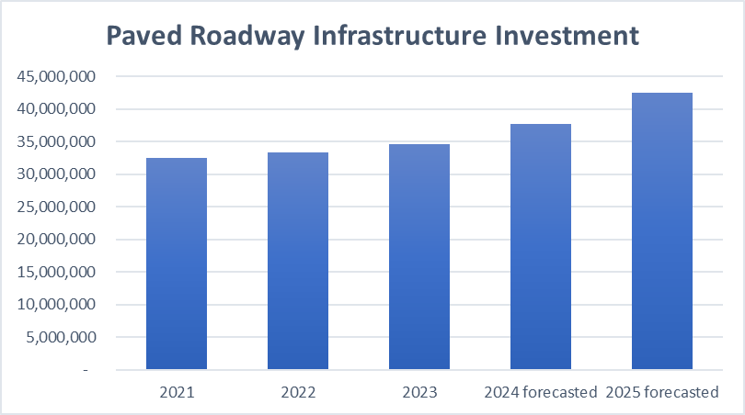
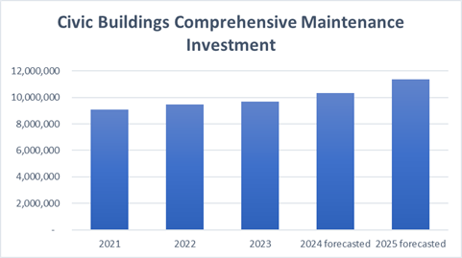
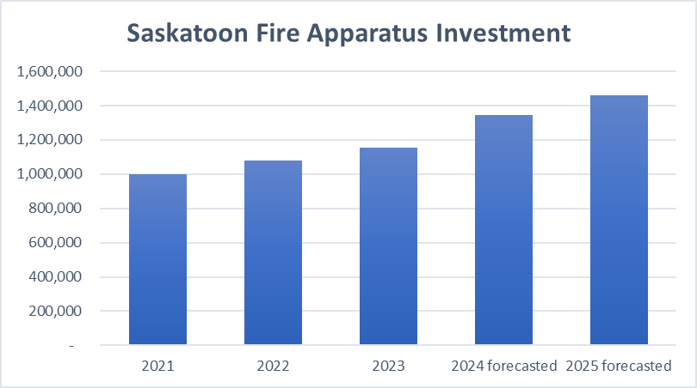

Slide 6
Potential Reduction Targets
Property Tax Impact | 2024 Reduction Required | 2025 Reduction Required
9% | $26.87 million | N/A
6% | $35.46 million | $5.30 million
4% | $41.10 million | $11.48 million

Slide 7
Methodology #1 – Revenue + Expenditures

Slide 8
Methodology #2 – Funding Gap Allocation

Slide 9
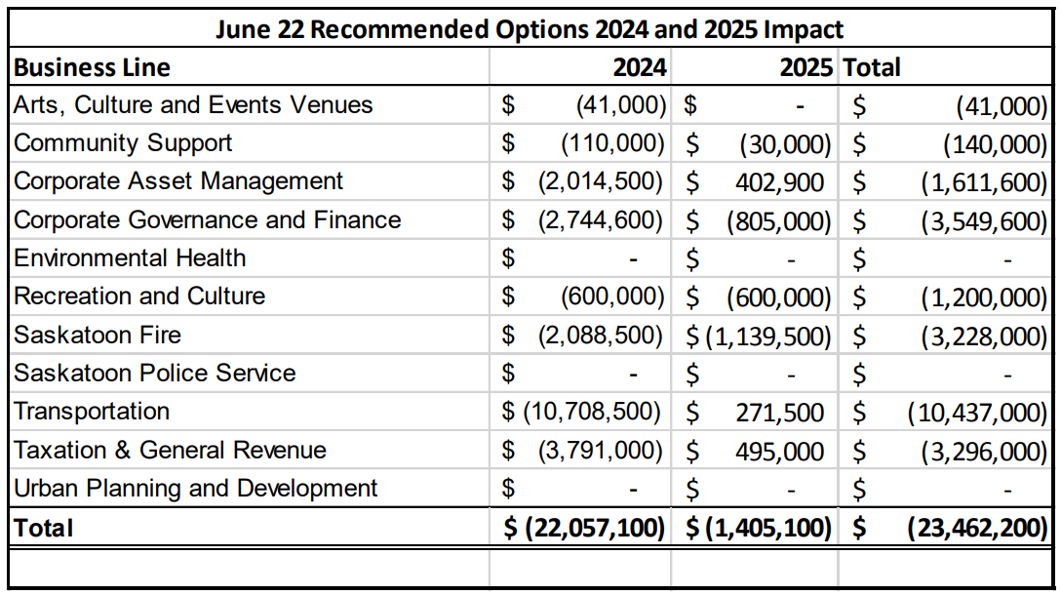
Impact of Proposed Recommendations

Slide 10
Next Steps
The Preliminary Business Plan and Budget will be built based on direction provided up until the end of August
Final Confirmation at Budget Deliberation of all changes
  Opportunity to adjust recommendations

Slide 11
Community Support Business Line

Slide 12
Revenue Overview
Service Line | 2023 Op Rev (in millions) | % of Overall Op Rev.
Animal Services | $0.82 | 29.29%
Cemeteries | $1.59 | 56.79%
Community Development | $0.39 | 13.92%
Community Investments & Support | $0.00 | 0.00%
Community Support Business Line | $2.80 | 100.00%

Slide 13
Expenditure Overview
Service Line | 2023 Op. Exp. (in millions) | % of Overall Op. Exp.
Animal Services | $ 2.05 | 9.50%
Cemeteries | $ 1.62 | 7.50%
Community Development | $ 4.07 | 18.85%
Community Investments & Support | $13.85 | 64.15%
Community Support Business Line | $21.59 | 100.00%

Slide 14
2024/2025 Key Pressures
Item | 2024 Amount | 2025 Amount
Animal Services Contract Increases | $271,000 | $42,300
Abatements & Economic Incentives | ($366,800) | ($363,000)
Youth Sport Subsidy |  | $137,500
Meewasin Valley Authority Grant | $42,800 | $36,900

Slide 15
Options
Option | Description | Potential
1A | Reduction Special Event Grant and/or Provision for Civic Services | $0 to $431,000 $0 to $245,000
1B | Reduction to Youth Sport Subsidy | 1% = $57,000
2 | 10% Pet License Increase | $80,000
3 | Additional 3% Cemetery Rate Increase | $60,000
4 | Decrease Transfer to Cemetery Development Fund | $62,400
5 | Reduce Service Level Cemetery Maintenance | $20,000
6 | Reduce Perpetual Care Fund Transfer | $0 to $77,300

Slide 16
Fire Services Business Line

Slide 17
Revenue Overview
Service Line | 2023 Op Rev (in millions) | % of Overall Op Rev.
Fire Services | $1.20 | 94.49%
Emergency Management | $0.07 | 5.51%
Saskatoon Fire Business Line | $1.27 | 100.00%

Slide 18
Expenditure Overview
Service Line | 2023 Op. Exp. (in millions) | % of Overall Op. Exp.
Emergency Management | $1.57 | 2.72%
Fire Services | $56.05 | 97.28%
Saskatoon Fire Business Line | $57.62 | 100.00%

Slide 19
2024/2025 Key Pressures
Item | 2024 Amount | 2025 Amount
Asset Manager | $140,300 | -
Operations Dispatch Manager | $140,300 | -
Communications Consultant | $115,700
Fire Station #3 & #5 Maintenance | $249,300
Fire Communications Centre Technology | $277,500 | $187,500

Slide 20
Options
Option | Description | Potential
1A | Defer Asset Manager Position | $140,300
1B | Defer Operations Dispatch Manager | $140,300
1C | Defer Communications Consultant | $115,700

Slide 21
Arts, Culture & Event Venues Business Line

Slide 22
Expenditure Overview
Gross Expenses | 2023 Op. Exp. (in millions)
Remai Modern Art Gallery | $7.3
SaskTel Centre | $0.6
TCU Place | $1.8
Arts, Culture and Events Business Line | $9.7

Slide 23
2024/2025 Key Pressures
Item | 2024 Amount | 2025 Amount
Remai Modern CBCM Increase | $41,000 | -
Remai Subsidy Increase | $134,000 | $115,000

Slide 24
Options
Option | Description | Potential
1 | Defer Remai Modern CBCM Phase-in | $41,000

Slide 25
Taxation & General Revenue Business Line

Slide 26
Revenue Overview
Service Line | 2023 Op Rev (in millions) | % of Overall Op Rev.
Fines and Penalties | $13.92 | 2.82%
General Revenue | $83.62 | 16.92%
Grants in Lieu of Taxes | $46.53 | 9.41%
Municipal Revenue Sharing Grant | $54.67 | 11.06%
Other Levies | $3.49 | 0.71%
Property Levy | $292.00 | 59.08%
Taxation and General Revenues Business Line | $494.23 | 100.00%

Slide 27
Expenditure Overview
Service Line | 2023 Op. Exp. (in millions)
Fines and Penalties | $5.98
General Revenue | $(1.57)
Grants in Lieu of Taxes | $ -
Municipal Revenue Sharing Grant | $ -
Other Levies | $0.77
Property Levy | $0.67
Taxation and General Revenues Business Line | $5.85

Slide 28
2024/2025 Key Pressures
Pressures Considered in Earlier Reports | 2024 Amount | 2025 Amount
Item | 2024 Amount | 2025 Amount
SL&P ROI Phase-Out | $3,300,000 | -
Item | 2024 Amount | 2025 Amount
Interest Stabilization Phase-Out | $100,000 | -
Traffic Provincial City Violations | $200,000 | ($50,000)

Slide 29
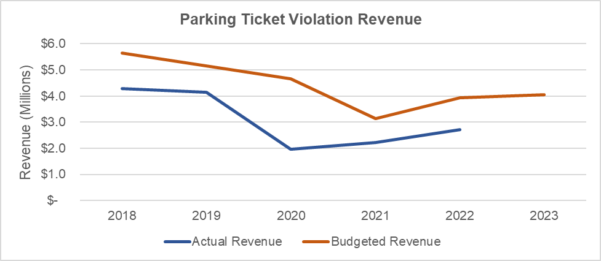

Slide 30
Options
Option | Description | Potential
1 | Interest Stabilization Removal Phase-in | $50,000
2 | Tax Certificate/Search Fee Increase | $282,000
3 | Property Tax Penalty Increase | $424,000
4 | Parking Ticket Penalty Increases | $560,000

